Slide 1
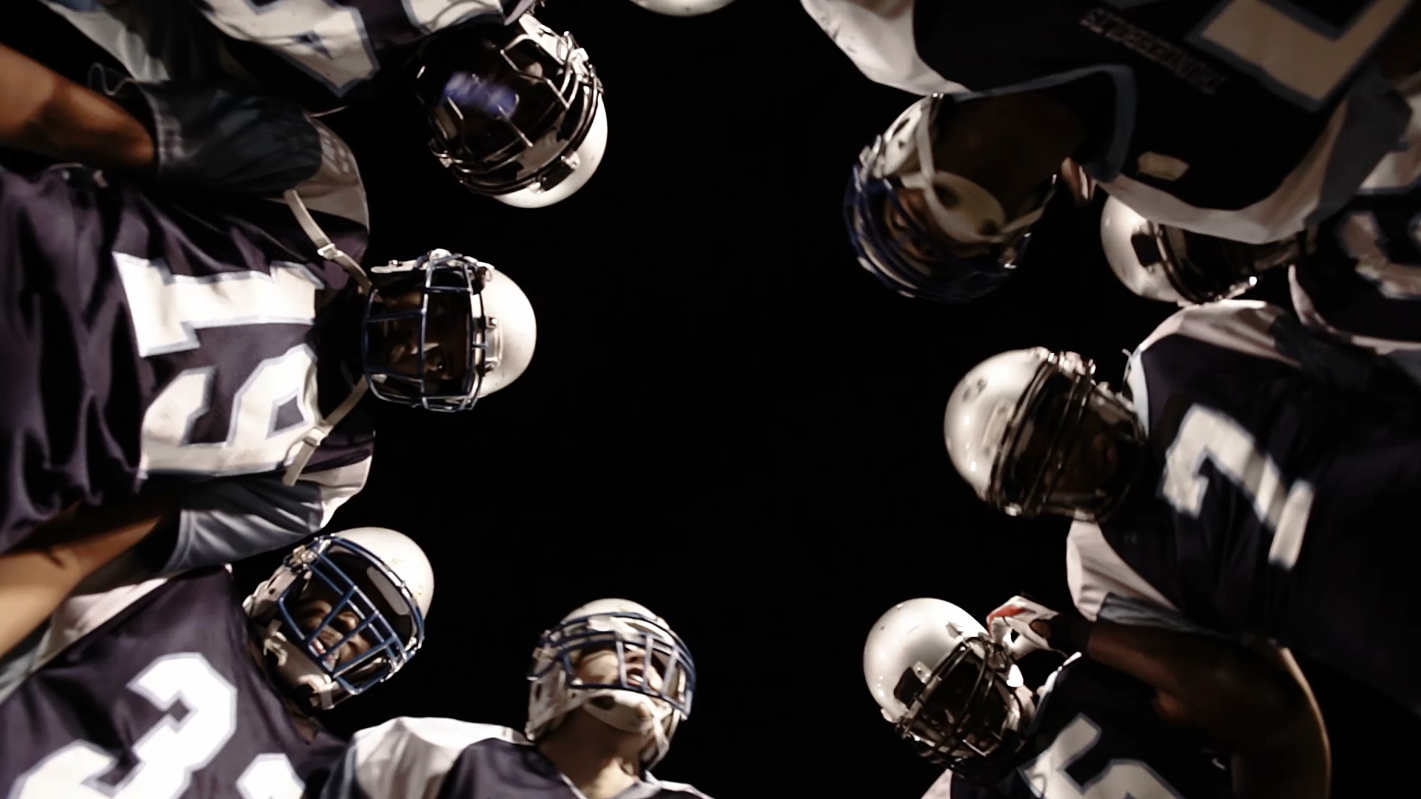
NFL Sports Betting Analysis
Betting for Starters
By: Dario Micucci, Justin Butler,
Rebeca Perez & Brettney Chau-Dang

Slide 2
Introduction
Objective/Purpose of Project/Description
Who would you place your bet on?

Slide 3
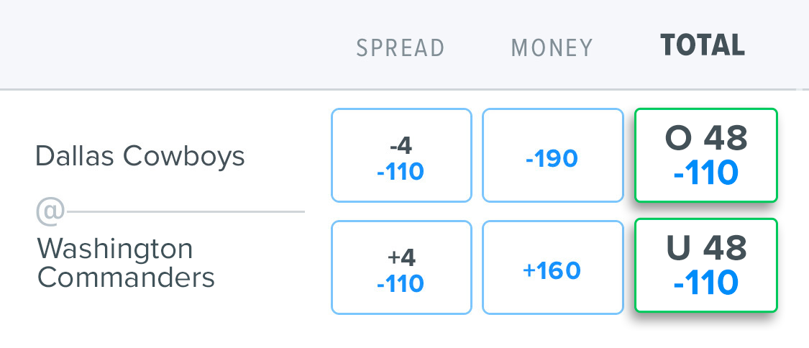
Over
/
Under
AKA. “Totals Bet”
A bet on the total combined score of a single game
Higher or lower than a pre-determined value

Slide 4
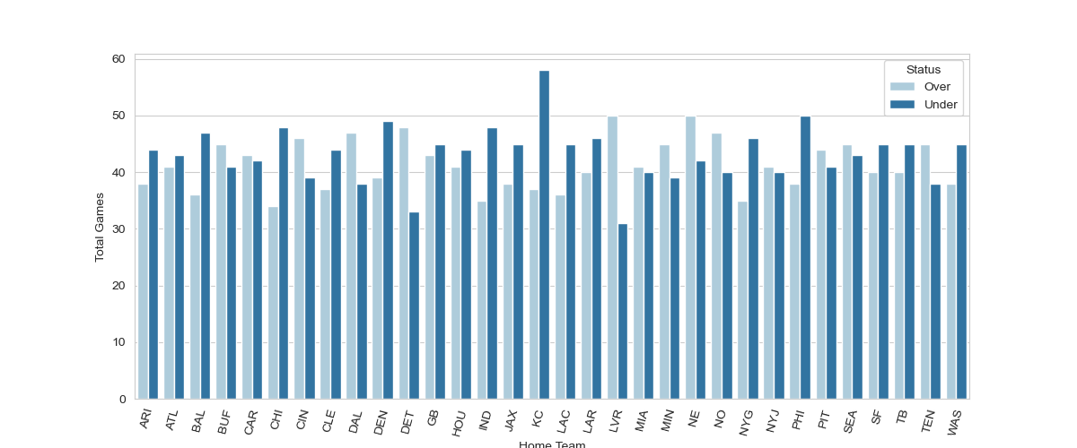
Total Games vs. NFL Team
Top NFL Team that was Over
Top NFL Team that was Under

Slide 5
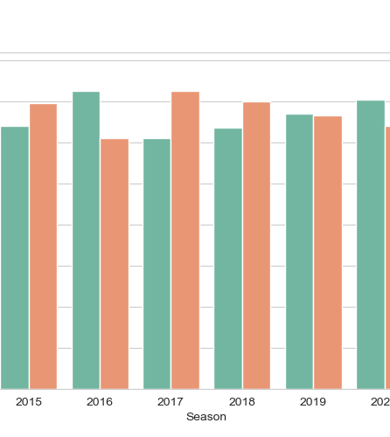
Total Games vs. Season
Regular season games from 2013 to 2022
Total amount of games that were higher or lower
60% of games were Under over the last 10 Seasons

Slide 6
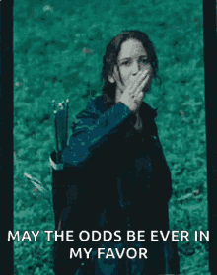
Good Luck!

Slide 7
References
https://www.kaggle.com/datasets/tobycrabtree/nfl-scores-and-betting-data
https://github.com/jp-wright/nfl_betting_market_analysis
https://sportsdata.io/developers/api-documentation/nfl#
https://github.com/jp-wright/nflgame
https://www.kaggle.com/code/twalters20/nfl-betting-model
https://www.kaggle.com/datasets/tobycrabtree/nfl-scores-and-betting-data?select=spreadspoke_scores.csv
https://www.kaggle.com/datasets/tobycrabtree/nfl-scores-and-betting-data?select=nfl_stadiums.csv
https://www.kaggle.com/datasets/tobycrabtree/nfl-scores-and-betting-data?select=nfl_teams.csv
https://www.kaggle.com/datasets?tags=16133-Gambling
https://tenor.com/search/hungergames-gifs

